Slide 1
Phonetics
Study of speech sounds
26 letters in the English alphabet
44 sounds-24 consonants and 20 vowels
IPA system followed for uniformity
International Phonetic Association
International phonetic alphabet
Phonetic transcription (symbol)

Slide 2
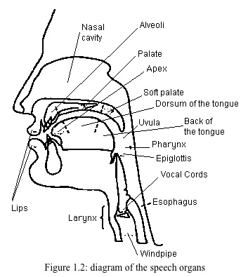
Organs of Speech

Slide 3
Speech Mechanism
Respiratory system:
lungs, bronchial tubes and wind pipe
Phonatory system:
larynx/voice box- vocal cords, glottis
Articulatory system
lips,mouth,teeth,tongue

Slide 4
Types of sounds
Voiceless sounds: free passage of air
vocal cords are drawn wide
glottis opened
ex. [p,t,k,ts,f,0,s,s,h]
Voiced sounds: vocal cords loosely held together
restricted passage of air
vibration in vocal cords
ex. vowels, remaining consonants

Slide 5
Consonants – Place of articulation
Bilabial- two lips [p,b]
Labiodental- lip +teeth [f,v]
Dental- teeth
Alveolar- teeth ridge [t,d,l]
Post-alveolar- above teeth ridge [r]
Palato-alveolar- hard palate+ teeth ridge
Palatal- palate [j]
Velar – [k,g]
Glottal- [h]

Slide 6
Consonants-Manner of Articulation
Plosives 6 [p,b]
Affricates 2 [as in child, judge]
Nasals 3 [m,n]
Lateral 1 [l]
Fricatives 9 [f,v,]
Frictionless continuant 1 [r]
Semi-vowel 2 [j,w]

Slide 7
Different pronunciations
Inflexional Suffixes : /t/,/d/,/Id/
/t/ kicked - /kIkt/
/d/ begged - /begd/
/Id/ blessed - /blesId/
Plurals : /s/, /z/, /Iz/
/s/ cats - /caets/
/z/ cities -/sItIz/
/Iz/ buses- /busIz/

Slide 8
Exercises
Pronounce:
Club bomb
Comb plumber
Debt limb
Thumb lamb
Doubt Dumb
Silent consonants

Slide 9
Hoar
Honesty
Honour
Honourable
Knowledge
Know
Kneel
Knock
knot
Autumn
Solemn
Hymn
Column
Muscle
Handkerchief
Wednesday

Slide 10
Reign
Foreign
Foreigner
Design
Resign
Sign
Talk
Walk
Palm
Calm
Could
Would
Should
Calf
Chalk
yolk

Slide 11
Vowels
There are 20 vowels in English Language
They are broadly divided into 2 types
Pure vowels – 12, divided on the place of articulation
They are: front, central and back vowels
Diphthongs – 8
They are closing and centring diphthongs

Slide 12
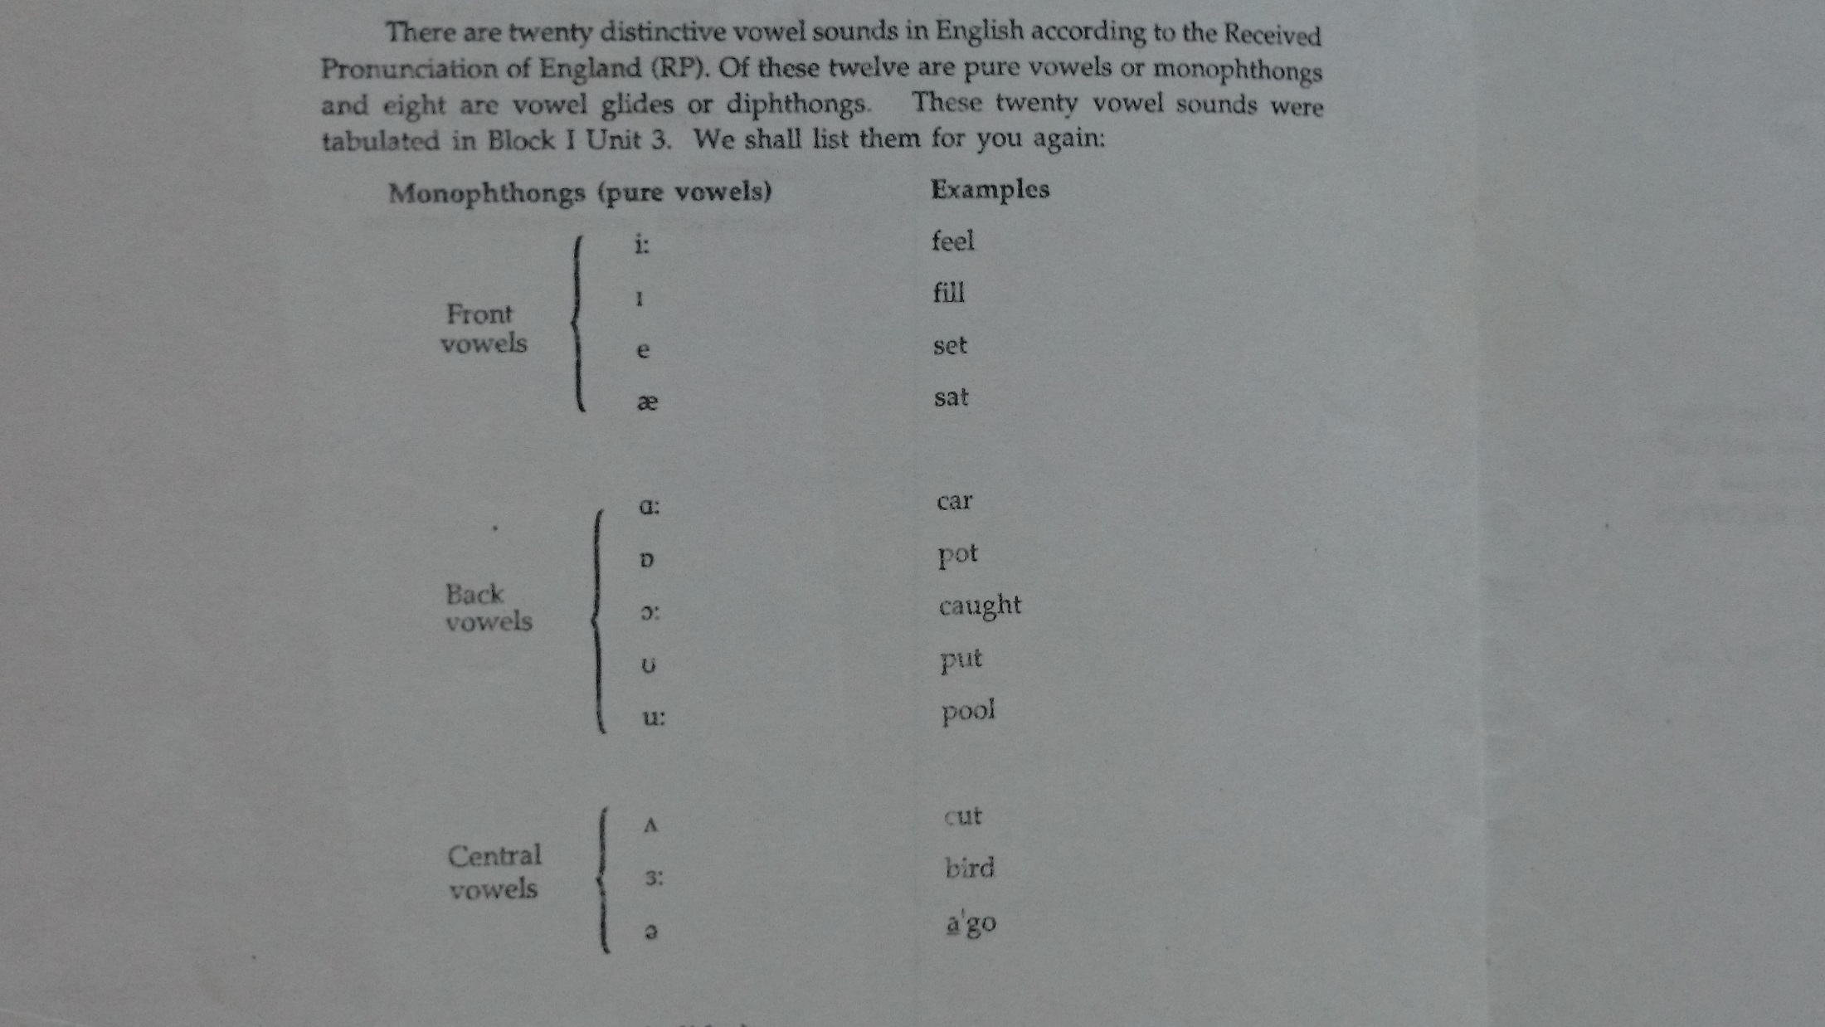

Slide 13
